Slide 1
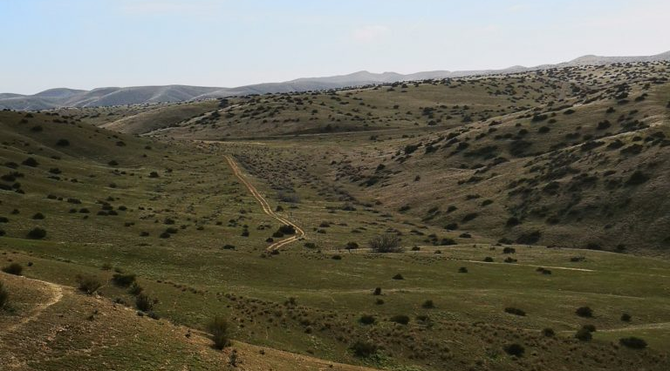
Climatic scaling effects of foundation plant species interactions with vertebrate species.
Nargol Ghazian
Progress Report
Spring 2020
Notes:
Nargol Ghazian
Progress Report
Spring 2020

Slide 2
Chapter | Title | Achievement Highlights | Future Goals
1 | A picture is worth a thousand hours: a systematic review of camera trap papers to test for reported sampling effort. | Data extraction completed | QA/QC and well as GLMs needed (April-May) Use as general intro to thesis
2 | Plant-animal interactions and microclimate. | Field season done May 15th to June 15th, 2019 Camera traps from Panoche and Carrizo are processed | Combine with third chapter
3 | Effects of artificial shelters on canopy microclimate in arid and semi-arid regions: a potential tool for conservation. | First manuscript written and edited by CJL Shrub-open logger data added to analyses | Process shelter camera traps and add data to study Finalize stats and write second manuscript

Slide 3


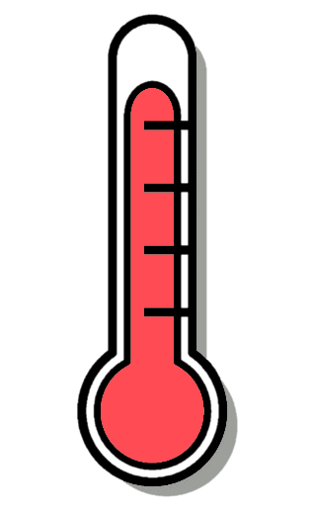



Background

Slide 4
CH1: A picture is worth a thousand hours: A systematic review of camera trap papers to test for reported sampling effort.
Purpose: Identify the relevant literature using camera trapping to examine species richness and diversity as an index of sampling effort.
Questions:
How many hours, days, or months are needed to estimate species richness and diversity in a given ecosystem using a camera trapping tool?
What taxa are usually recorded?
Do abiotic parameters such as temperature function as a covariate when predicating species richness?
What sort of studies are camera traps used for?

Slide 5
Papers obtained through database searching (Web of Science) Keywords:
Camera* Trap* AND Richness*, Diversity*, and Rarefaction* Curve*
(n= 515)
Identification
Papers obtained from other sources, such as book chapter bibliographies
(n= 0)
Records after duplicates removed (n = 397)
Eligibility
Records screened by abstract (n = 397)
Records excluded for: relevance, review, opinion or idea paper, focus on one spices, qualitative, not English.
Screening
Full-text articles assessed for eligibility (n = 252)
Full-text articles excluded:
Not reporting richness or diversity, number of records, and any measure of duration.
Include in synthesis
(n = 119 )
Extracted data:
Location (lat, long), duration.hours, duration.months, camera trap days, number of records, animal richness, scientific name, year, number of cameras, number of sites, month of study, type of ecosystem, study design, and some measure of temperature for study period
Included
PRISMA diagram (Moher et al. 2009). Keyword search done on January 27th, 2019.

Slide 6
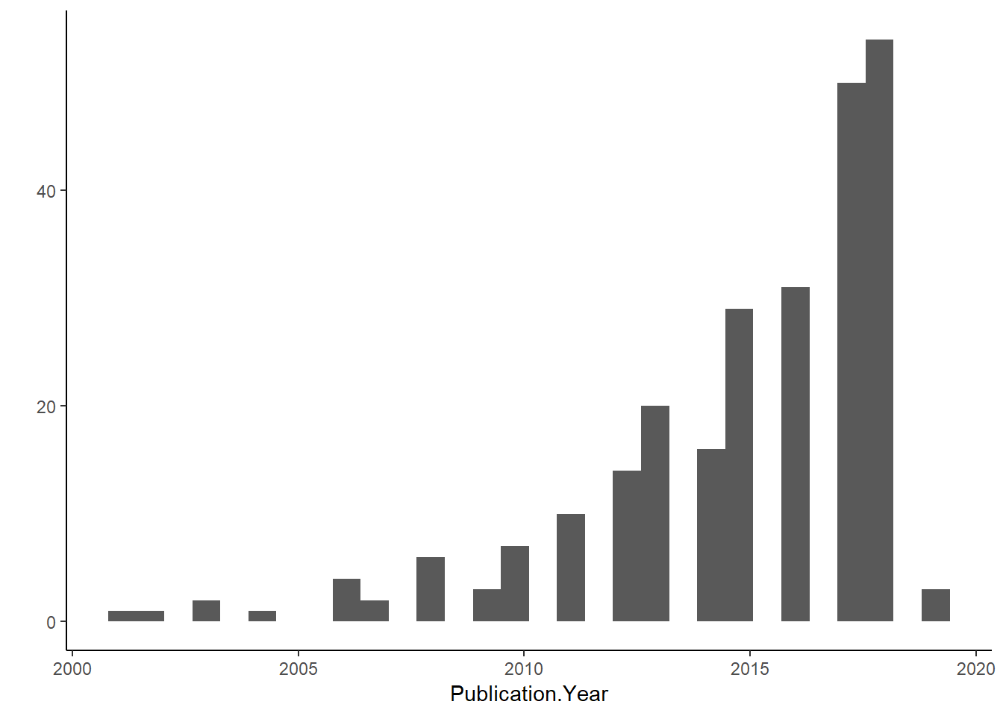
Future Directions:
QA/QC on data
Simple Generalized Linear Models (GLMs) on frequency of key attributes
Generate an evidence map
Use as general intro to thesis

Slide 7
CH2: Plant-animal interactions and microclimate.
Purpose: To examine whether animal association patterns with shrubs are explained by microsite level fluctuations in temperature and light.
Questions:
To what extent do radiation intensity, air, and soil temperature influence the association of vertebrates with foundational plants?
How does the strength of this association change as the above microclimatic parameters increase or decrease?
Is this association species-specific and does it depend on the animal’s lifestyle?

Slide 8
Hypotheses: Shrubs act as thermal refuges for many desert animals by reducing temperature, reducing the amplitude of variation in microclimate, and providing refuge from direct sunlight.
Predications:
There are more animals associated with shrubs relative to open, non-canopy sites and the strength of this relationship increases with micro-environmental stress.
Shrub size predicts the strength of association between shrubs and protégé animals.
The facilitation refuge effect may be enhanced between abundance and richness of animal populations.
Microclimatic (ones site) and mesoclimatic (multiple sites) measures are more significant predictors of fine-scale animal abundances relative to the macroclimate of the region.

Slide 9
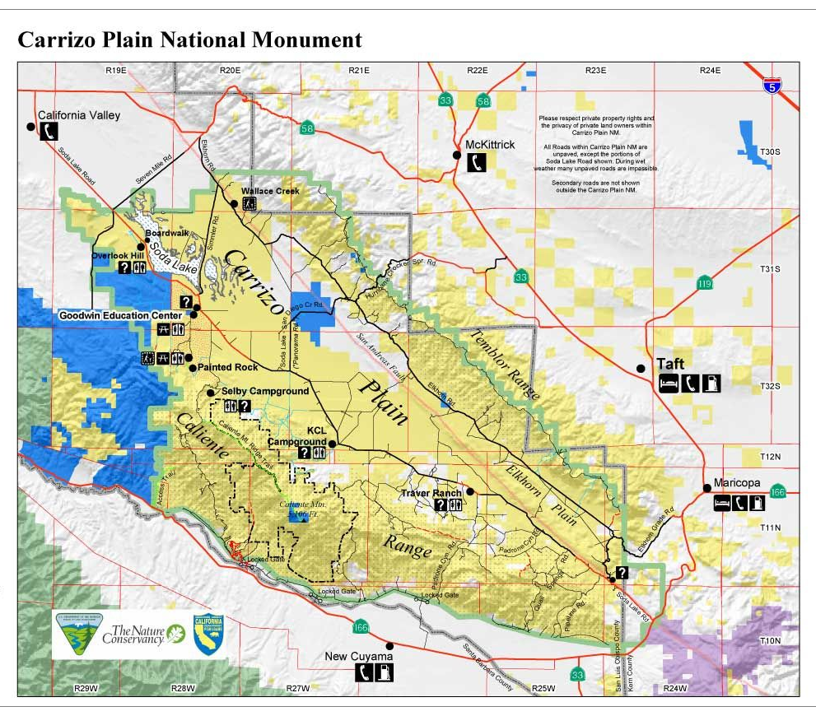
Location:
Carrizo
3
4
(Google Images)

Slide 10
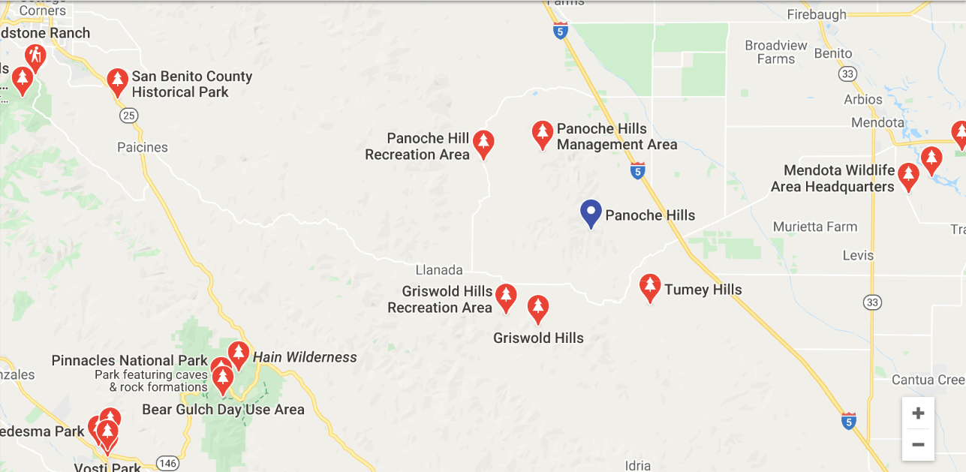
Location:
Panoche
(Google Maps)

Slide 11
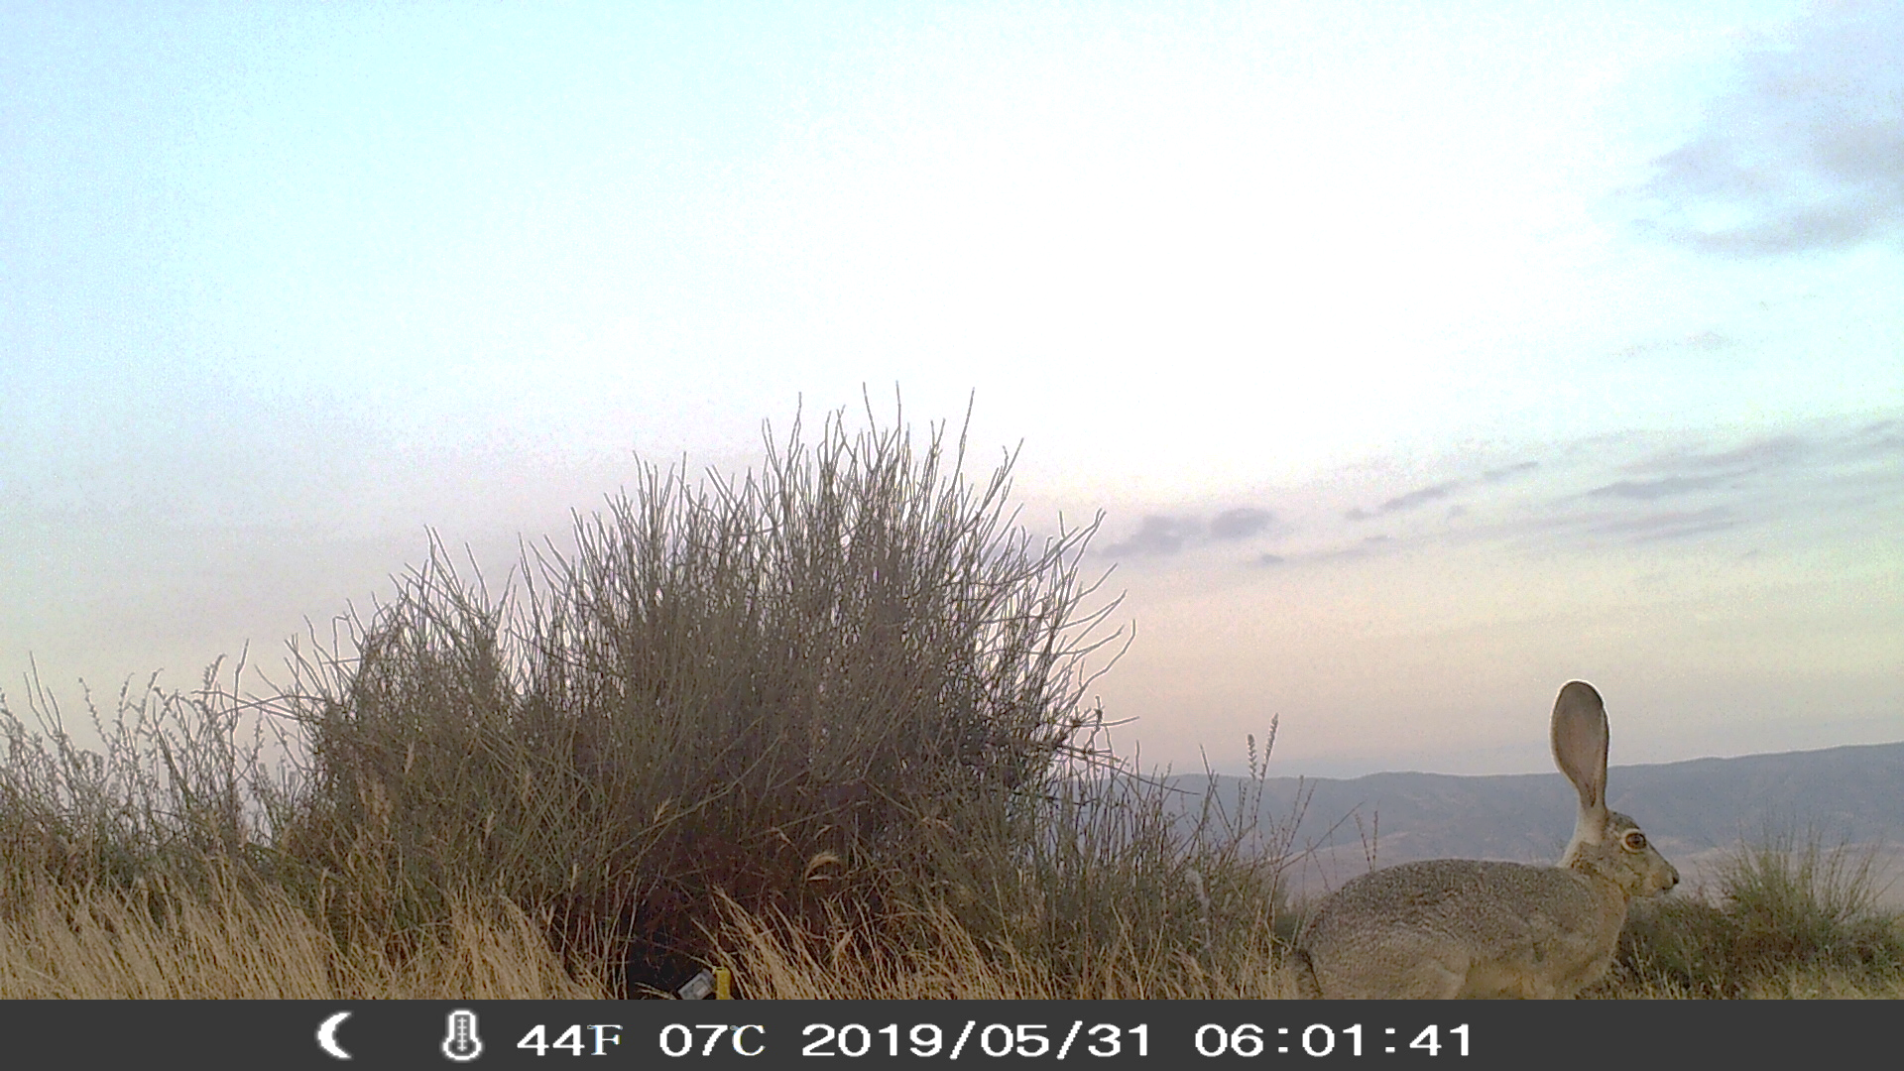


Set-up
Open
3 meters
3 meters

Slide 12
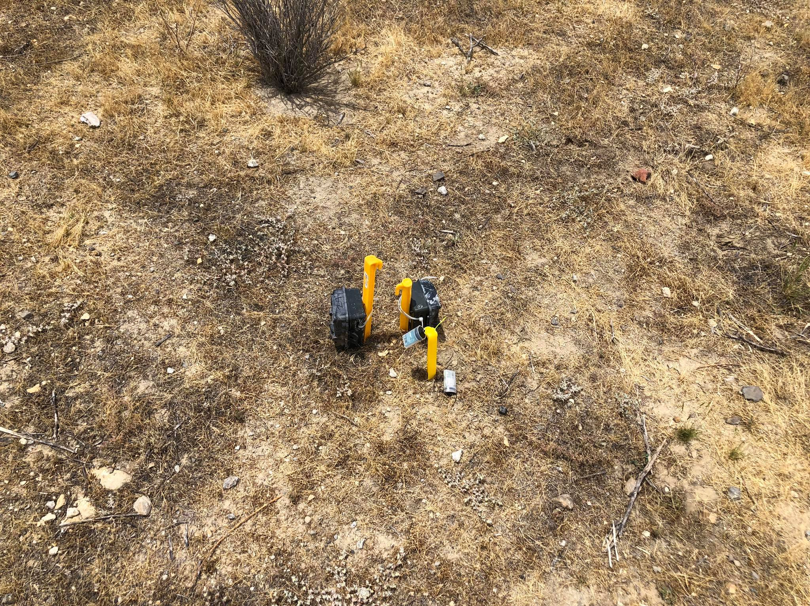
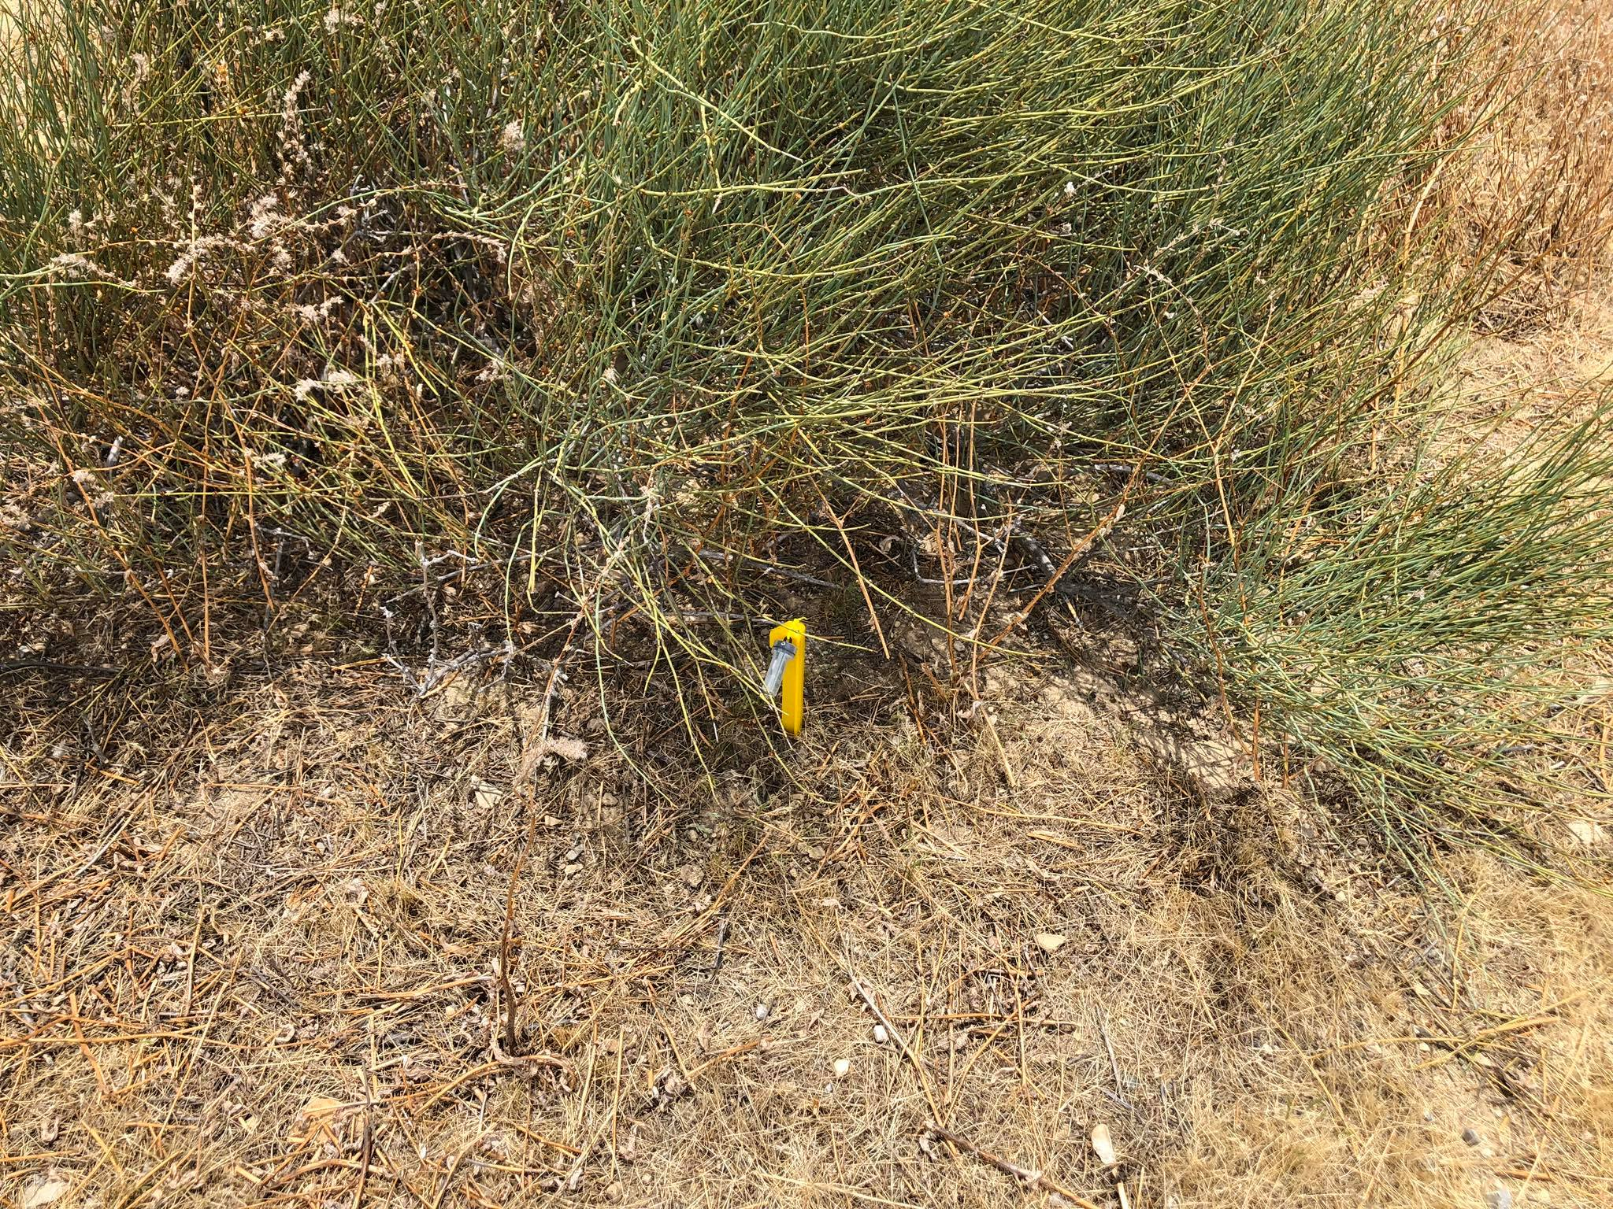

Slide 13
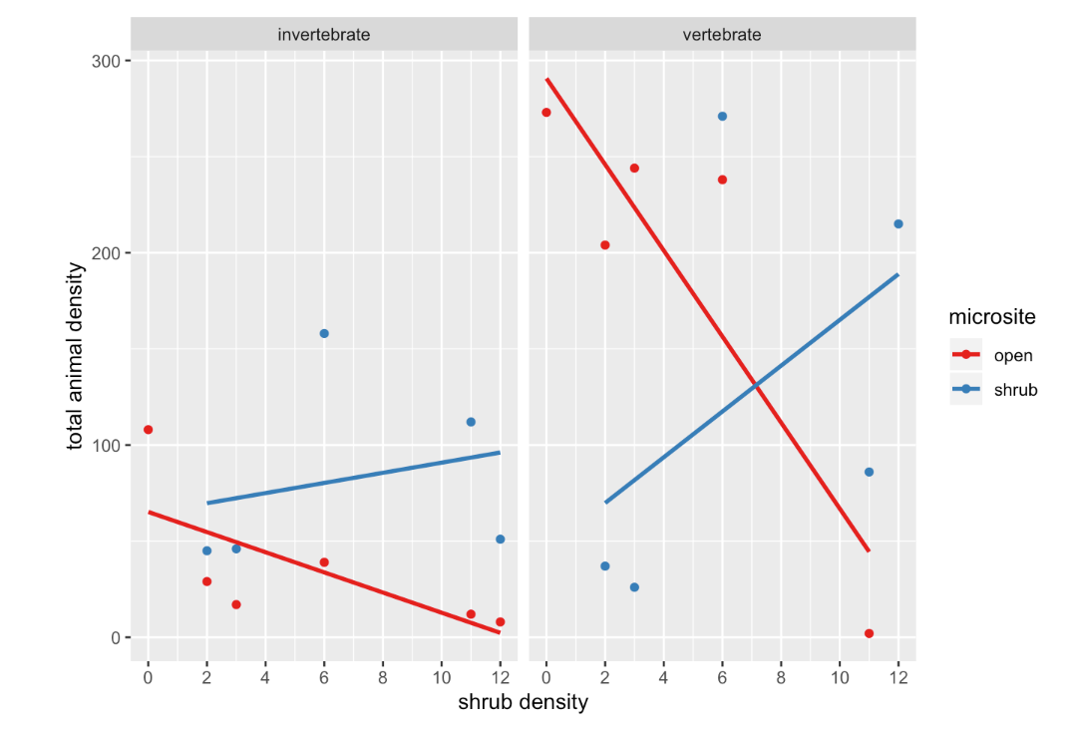
Preliminary Results
(Zuliani et al.)

Slide 14

(Zuliani et al.)

Slide 15
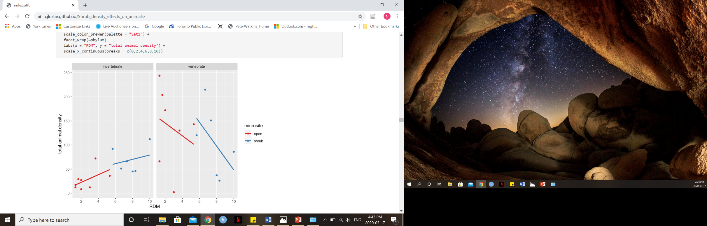

(Zuliani et al.)

Slide 16
Future Direction:
Test how temperature and light intensity influence the interaction between vertebrates and shrubs
Find a better weather station for the Carrizo macroclimate data
Tie in macroclimate
Test shrub vs. open vs. shelter for attracting vertebrates
Requires stats on camera traps from Panoche and Carrizo
Use existing shelter camera traps or do another field season and re-do

Slide 17
CH3: Effects of artificial shelters on canopy microclimate in arid and semi-arid regions: a potential tool for conservation.
Purpose: To describe the methodology of constructing artificial UV shelters for drylands, as well as exploring effects on canopy microclimate, including light and temperature.
Questions:
How does percent coverage of shelter material influence canopy microclimate?
To what extent does shape matter when it comes to temperature and light intensity?
What are the implication of this study for different climate change scenarios?
Can these shelters be used as a mode of conservation/restoration post anthropogenic disturbance?
How do shelters compare with shrubs in reducing temperature and light intensity under their canopy?

Slide 18
Location:
Panoche
(Google Maps)

Slide 19
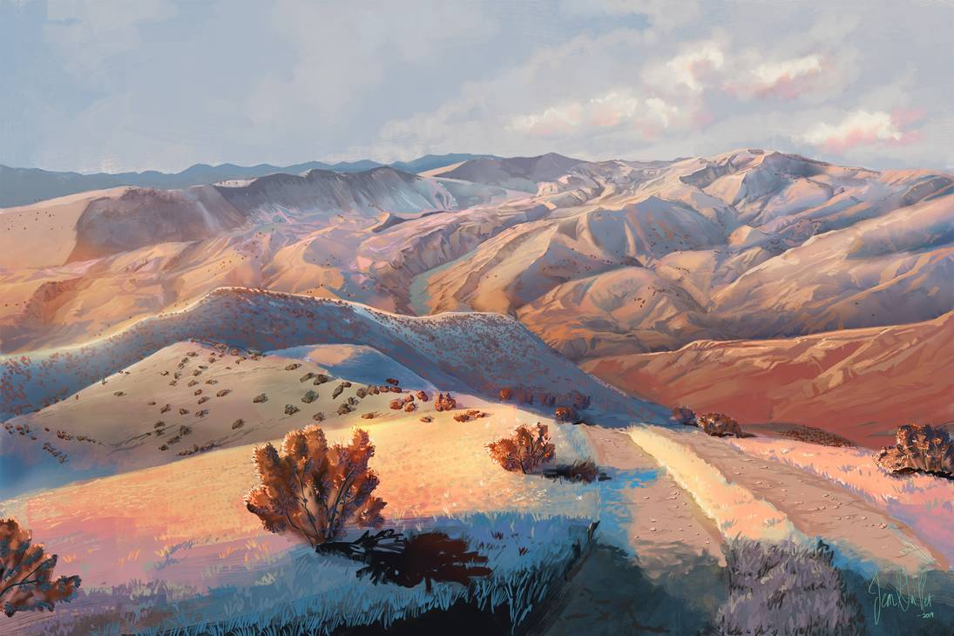
(Chateaugrief, 2019)

Slide 20
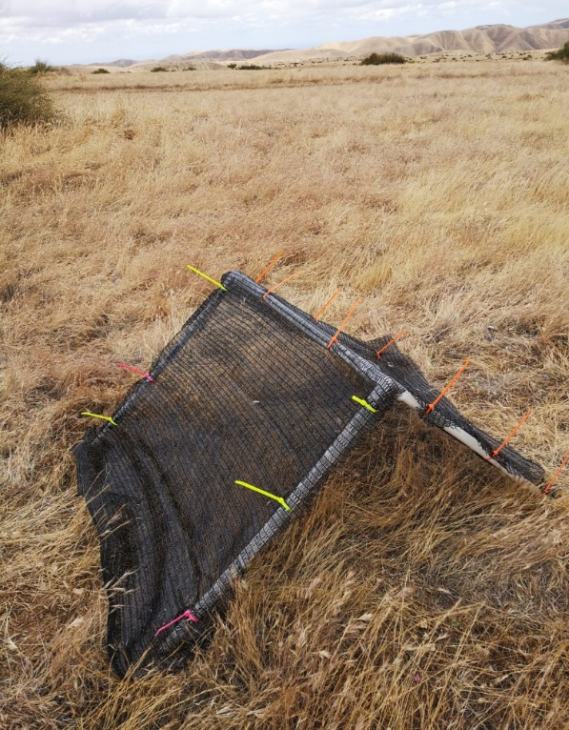
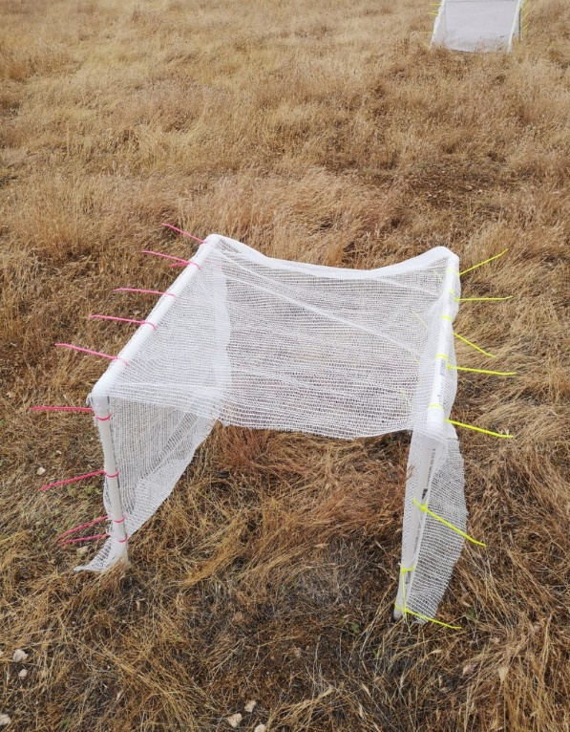
Notes:
3 covers, 2 shapes, 2 replicates of each

Slide 21
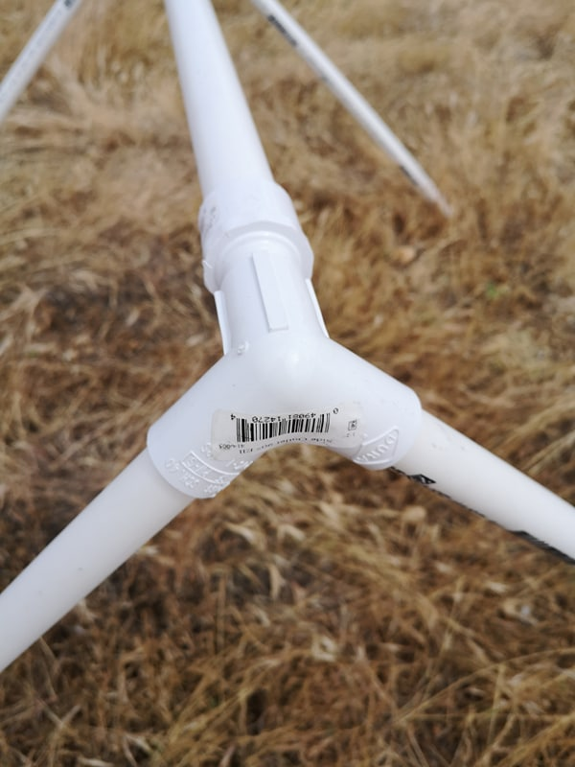
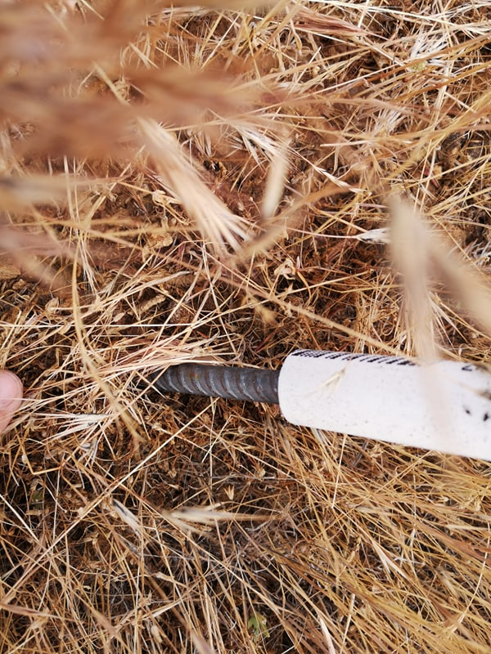

Slide 22
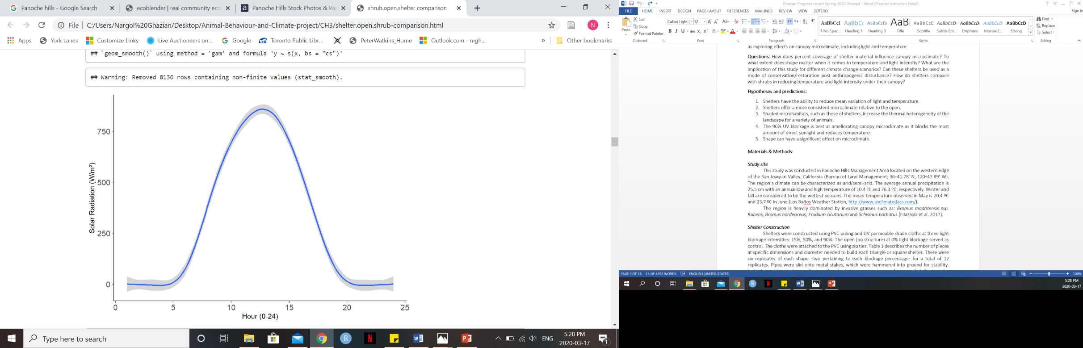


Slide 23
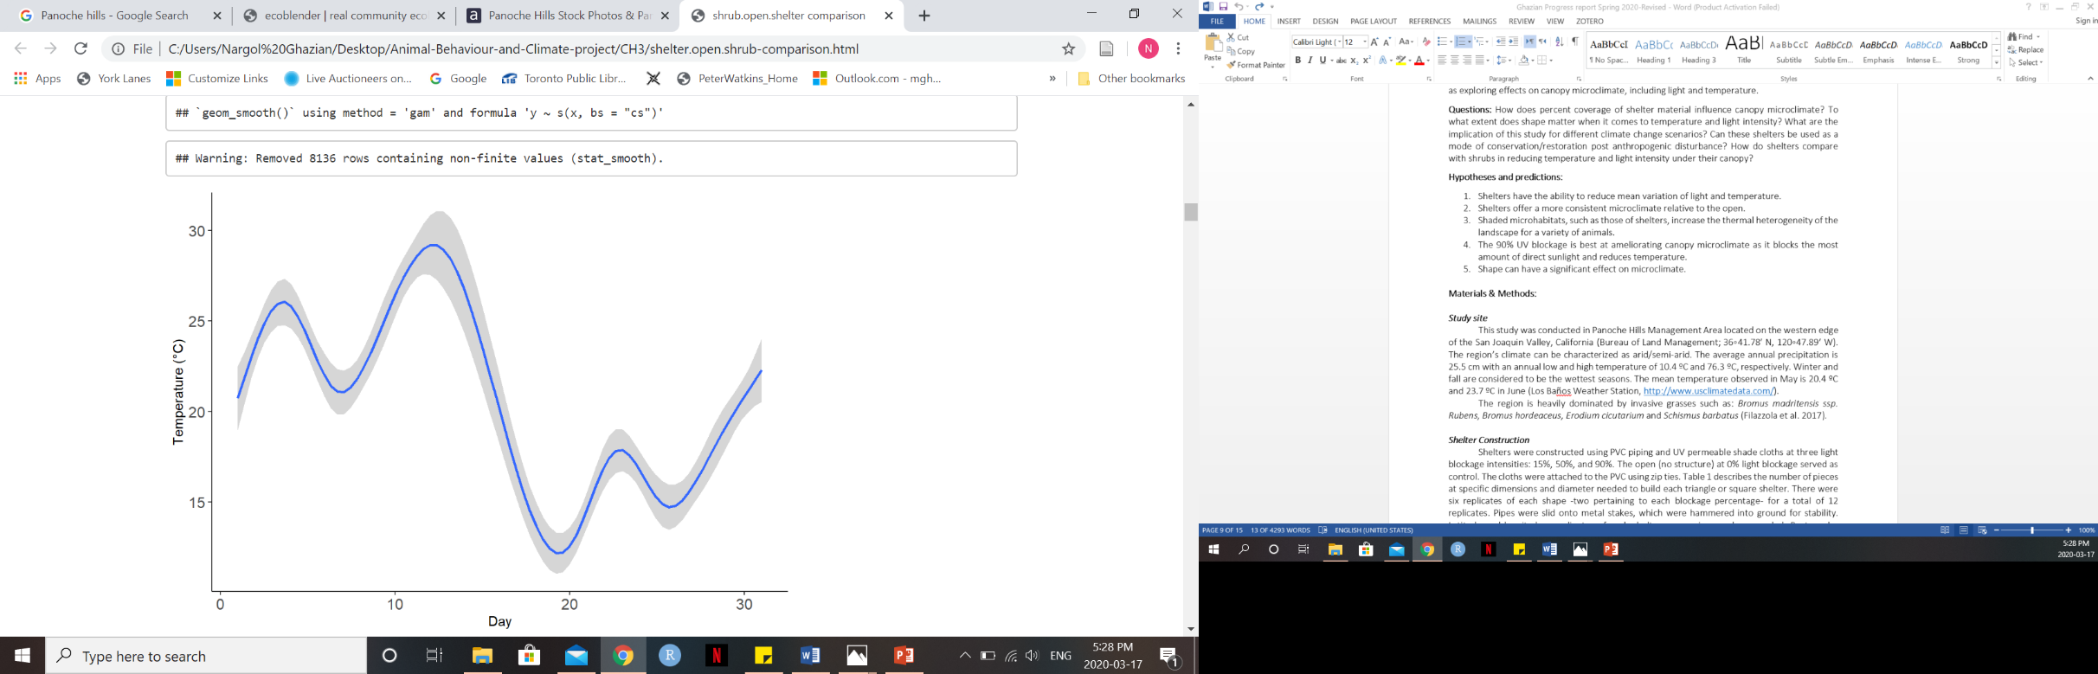
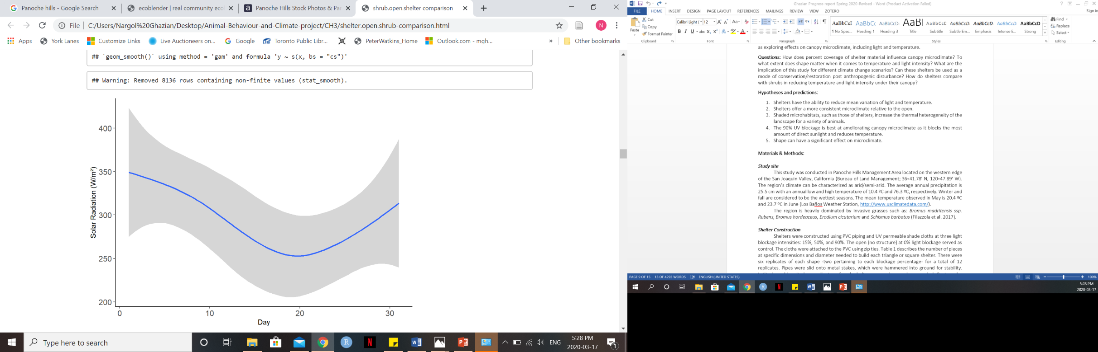

Slide 24
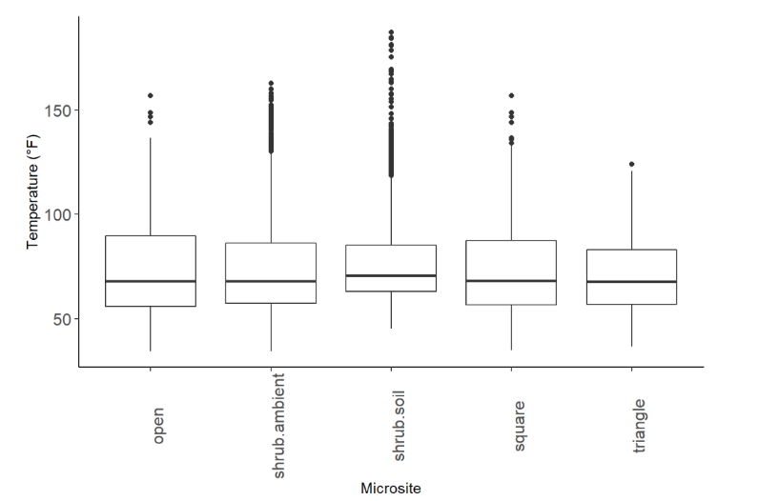

Slide 25


Slide 26
Contrast | SE | p-Value
Open-shrub.ambient | 0.0463 | <0.0001
Open-shrub.soil | 0.4303 | <0.0001
Shrub.ambient-square | 0.0483 | <0.0001
Shrub.ambient-triangle | 0.0558 | <0.0001
Shrub.ambient-shrub.soil | 0.4322 | <0.0001
shrub.soil-square | 0.4324 | <0.0001
Shrub.soil-triangle | 0.4333 | 0.0026
Notes:
Pairwise comparison of intensity GLM

Slide 27
Contrast | SE | p-Value
Open-shrub.soil | 0.476 | <0.0001
Open-triangle | 0.517 | <0.0001
Shrub.ambient-shrub.soil | 0.551 | <0.0001
Triangle-shrub.ambient | 0.586 | <0.0001
Square-shrub.soil | 0.569 | <0.0001
Triangle-shrub.soil | 0.629 | <0.0001
Square-triangle | 0.603 | 0.0026
Notes:
Pairwise comparison of temperature GLM

Slide 28
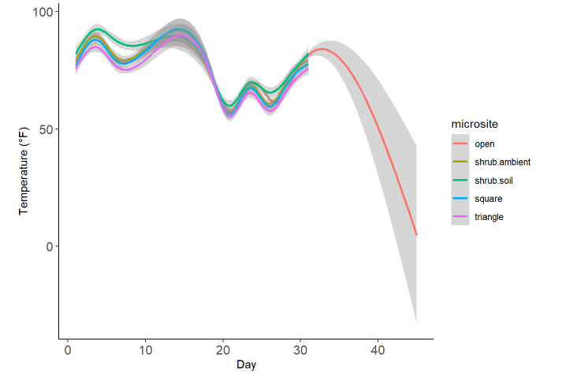

Slide 29
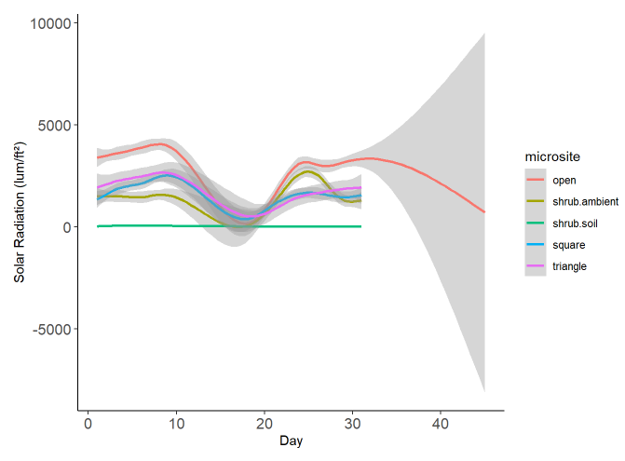

Slide 30
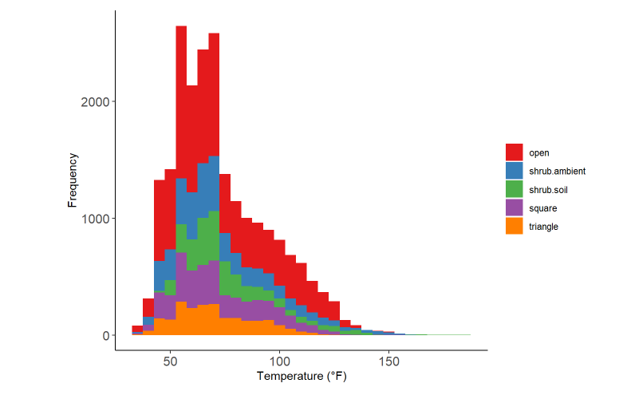

Slide 31
Preliminary Results:
There are significant differences between shelter, shrub, and the open when it comes to temperature and light intensity.
Open shows higher variation and a greater frequency at higher temperatures and intensity relative to all other microsites.
There is a positive relationship between light and temperature regardless of the time of the day.
Triangle was overall significantly better at reducing temperature relative to the open, shrub, and square shelter.
Natural shrubs are better at reducing light intensity compared to artificial shelters.
There is no significant difference in light reduction between triangle and square.

Slide 32
Future Directions:
Combine chapters 2 and 3.
How to tie in shelter cover intensity into all of this?
How to find a meaningful way to test variation?
Add animal camera trap analysis and RDM data into paper.
Write thesis!

Slide 33



Thank You!
Dr. Christopher Lortie
Dr. Suzanne MacDonald
Dr. Michael Westphal
Mario Zuliani
Ecoblender lab

